Slide 1
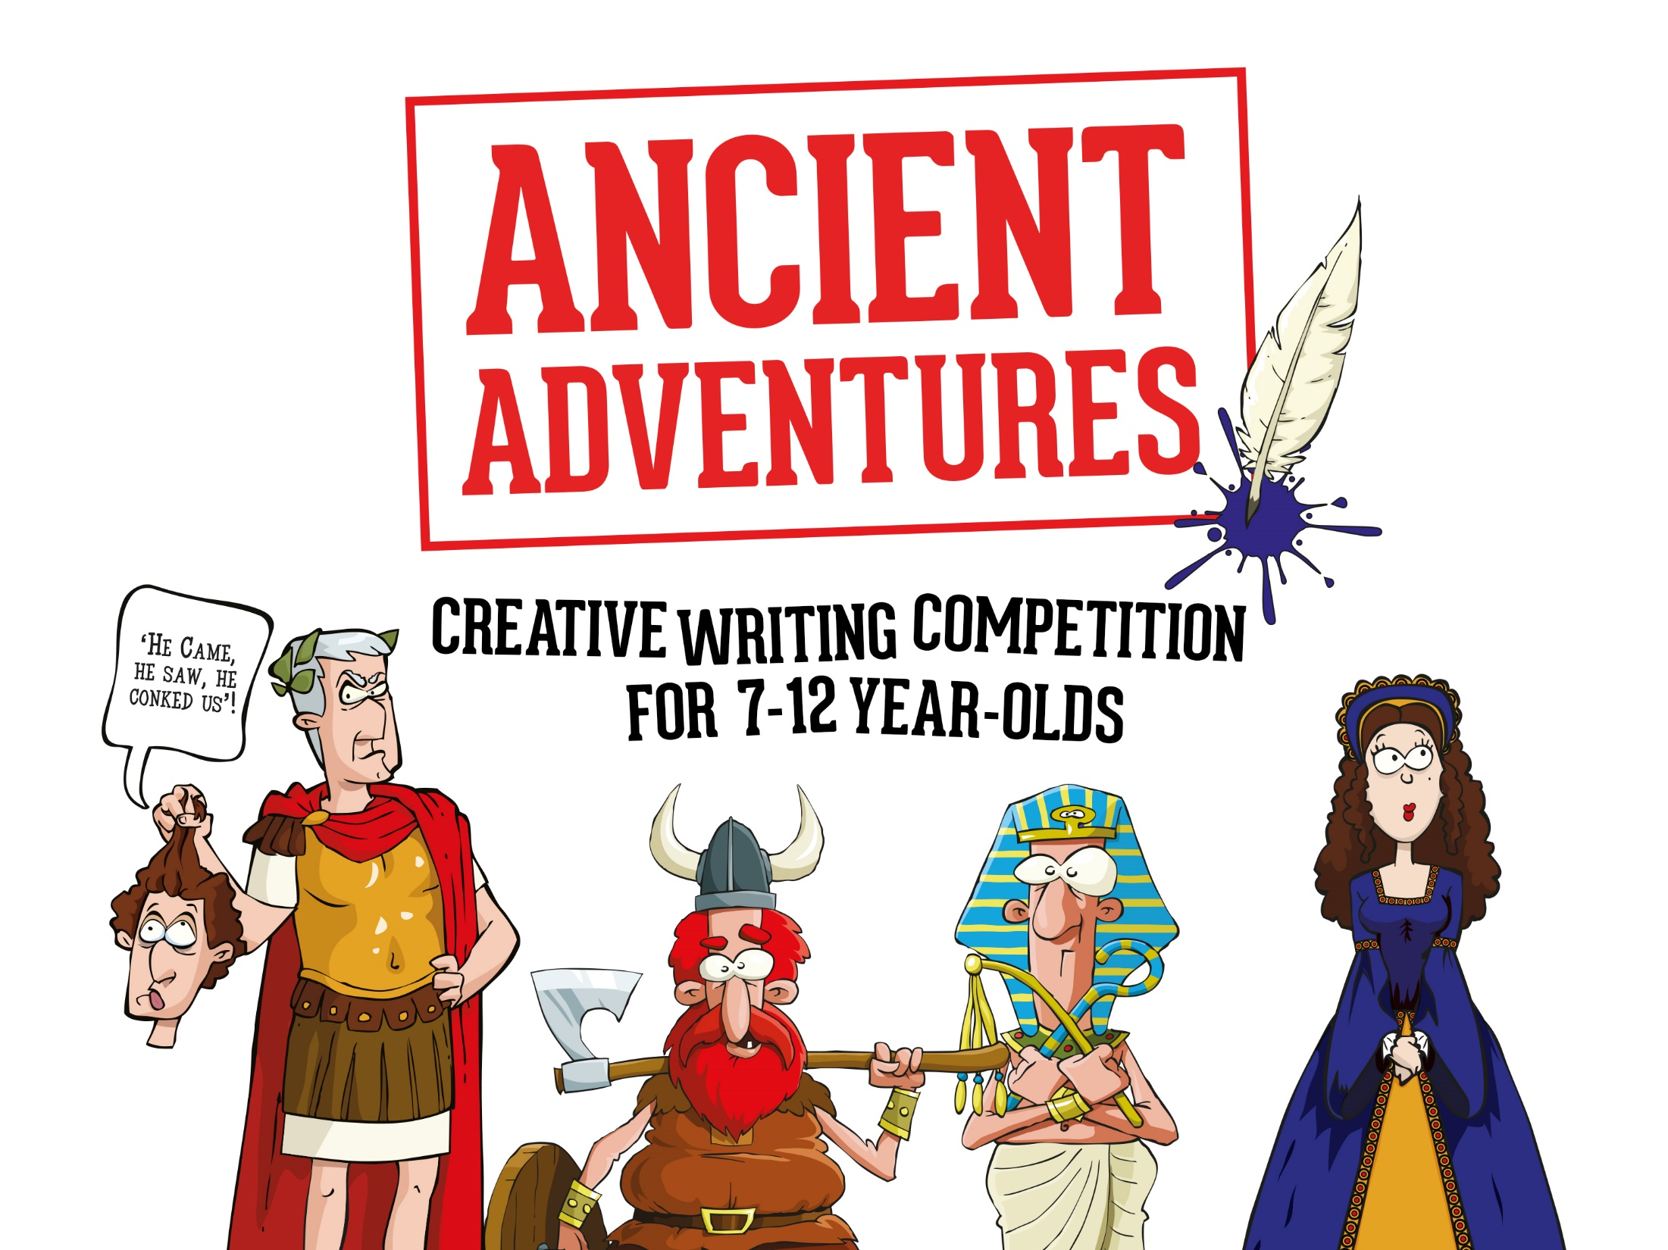

Slide 2


Today you are going to:
Learn what a mini saga is and how to write one
Discuss your ideas, offer opinions and suggestions in a group discussion
Expand your vocabulary
Plan, draft and write a mini saga for
‘Ancient Adventures’ creative writing competition

Slide 3
Grab a pen/pencil if you have paper or a worksheet to write on.
OR
You might be asked to type your work in the Online Writing Portal during this lesson.
Your teacher will let you know which option
you are using now!

Slide 4

What is a Mini Saga?
A mini saga is a story told in up to 100 words
It must have a beginning, middle and an end
It must be original – you can be inspired by any historical figure or period in history

Slide 5
What is a Story?
Tell your teacher your favourite historical event or story from history
Your teacher will pick one
Can you tell your teacher what happens using as few words as possible?

Slide 6
A Story’s Structure
The plot is the main events that happen in the story – you’ve just told your teacher the plot of the story you’ve been discussing
Setting – this is where the events happen, this could be in a forest, a desert, on the beach or in another country. In a mini saga, there is usually only one setting
Characters – these are the people/creatures in your story
Events – these are situations or actions that happen to move your story along, this could be someone being kidnapped, a strange visitor, falling out with a friend, meeting a hero, etc

Slide 7
Stories also need:
A beginning – action, dialogue or description to open your story
A middle – an event to move the story along
An ending - tie up loose ends or end on a cliff-hanger
Remember, a mini saga uses up to 100 words, which means you only have two or three sentences each for the beginning, the middle and the end!

Slide 8
Identifying Key Events
Earlier in the lesson you told your teacher a story’s plot in as few words as possible
Now it’s time to see if, as a class, you can summarise the story in 100 words...
Your teacher will make notes on the board
Once you have all the key events on the board, you can then work together to write a class mini saga. (See our tips on the next slide to help you!)

Slide 9
Tips
Be brutal – cut out any unnecessary words – do we need to know the building was high or the trees were green or that the main character likes eggs on toast for breakfast? If it’s not crucial edit it out!
Use ellipses (...) to suggest tension, excitement, mystery and suspense
Abbreviate words – ‘it is’ becomes ‘it’s’ / ‘you are’ become ‘you’re’ etc
You don’t have to get exactly 100 words, it can be fewer as long as you don’t go over!

Slide 10
Editing
Your teacher will read your class mini saga to you
Is there anything missing?
Is there anything you want to change?
Move words / lines around, add in or remove words, add in punctuation and when you are happy with it, count the words... If it’s over 100, see where you can abbreviate or edit words out.
Congratulations, you’ve written a mini saga! Now it’s time to try writing your own...

Slide 11
The 5 Ws
It’s time to think about the 5 Ws: who, what, where, why and when –
these will help you draft a rough plot of your story.
Your teacher may give you a person or time to write about, or if not you can use our idea generator to help you.
Who:
Who features in your story – just your main character or anyone else? Are they good or bad? Don’t add in too many characters as you only have 100 words to write your story in!
Where and When:
Where and when is the story set? We know it’s set in the past, but there’s a lot of history to choose from!

Slide 12
What:
What happens to your character?
Every story needs an event or conflict to move the plot along. Does your character save the day, have a problem or dilemma? Do they cause the problem or help to fix it? What will you choose?
Why:
Why does the event or conflict happen? Why does your character behave the way they do? Are they in the wrong place at the wrong time?
How will you resolve the conflict / dilemma or will you write a cliff-hanger ending…?
Use the planning boxes on your worksheet to write down your ideas.

Slide 13
Example 1
The Trojan Horse
The sand was hot beneath my toes, the sun beat angrily and sweat poured down my brow. The city walls were tall and strong and there was no way to scale them or break through. All of this because our queen had been stolen from us by that boy. Our king had brought us, his entire army, to claim her back. But how? We weren’t heroes or gods, just men. How could we possibly invade the mighty city Troy?
“Fetch wood,” I shouted suddenly. ‘We’ll sneak in.’
“How?” Achilles asked.
“A horse,” I said, ‘we will build a wooden horse.’

Slide 14
Example 2
Captured!
I thought of my mother and father but couldn’t remember their faces; it had been so long since I’d seen them. I couldn’t see anyone here, it was so dark. But I could smell them and hear them crying. We were crammed in like animals, unable to move, not allowed to speak. It had been just a normal day when they’d come. They came with chains and shackles and led us away. To the coast. To the boats. They said we were headed for England, they said it was the greatest country on Earth.
I only wanted to go home.

Slide 15
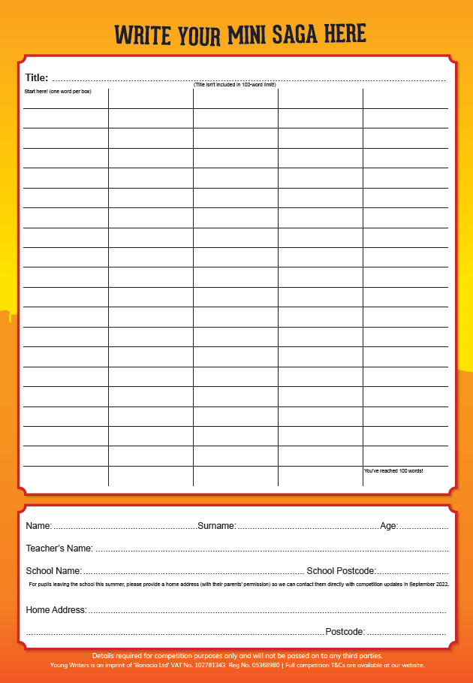
It’s time to write your mini saga!
Remember the 3 golden rules of mini saga writing:
A mini saga must be no more than 100 words
A mini saga must have a beginning, a middle
and an end
Write in your own words – every word counts, so choose carefully!
Your title isn’t part of your word count either!
Write in the 100-word grid on your worksheet.
If you have any questions ask your teacher now...

Slide 16
Assessment Time!
Your teacher will now tell you if you are working in groups or checking your own work.

Slide 17
It’s time to hand your work into your teacher!
Make sure your name and age
are on your work!
Well done for writing your
Ancient Adventure mini saga!

Slide 18
