Slide 1


Slide 2

Today you are going to write a poem
for Young Writers’
“This Is Me” competition!
Grab a pencil and paper or whiteboard or open Word etc on your computer to make your notes...
Let’s get started!

Slide 3

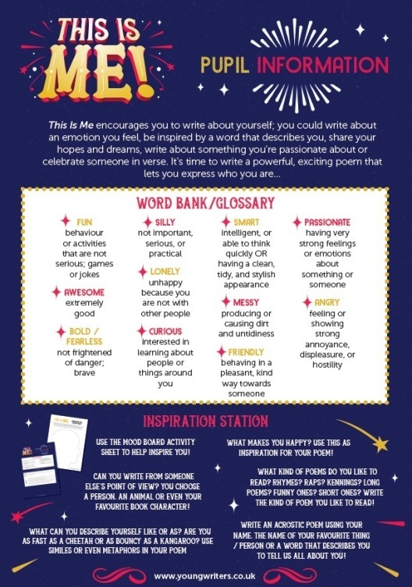
To help you write your poem there are some extra resources. These will help you generate ideas, plan and write your poem:
You also have different ways to enter, your teacher will let you know which way:
Student entry form (printed and completed in pen)
Word doc entry form (type entry into and save file as your name)
Online Writing Portal (you will be given a login link by your teacher and then follow the instructions on screen)
Mood Board Activity Sheet
Pupil Information Guide

Slide 4

You’re going to watch a short video to introduce you to the activity:
https://youtu.be/qBZfH2JYebg
Notes:
https://youtu.be/qBZfH2JYebg

Slide 5
What is a poem?
A poem is a piece of writing that uses imaginative words to share ideas and emotions with the reader using techniques such as imagery, repetition or simile.
The format of a poem could be:
a few short lines
in verses
one long verse
using a poetic form such as an acrostic, riddle or sense poem

Slide 6
Recently we interviewed poet Kate Wakeling, and she shared the lovely idea behind one of her poems. Kate said:
“I remembered poems are good at looking at ordinary things in a special way, so rather than just hunting for inspiration in more obviously ‘interesting’ places, I looked closer to home.
My poem ‘Paean (or Eleven Uses for a Garden Pea)’ is, well, all about what a pea might be if it weren’t just sat on a dinner plate (frog football; temporary emerald for edible ring; ocean-free planet…).”
And that idea has inspired this activity...

Slide 7
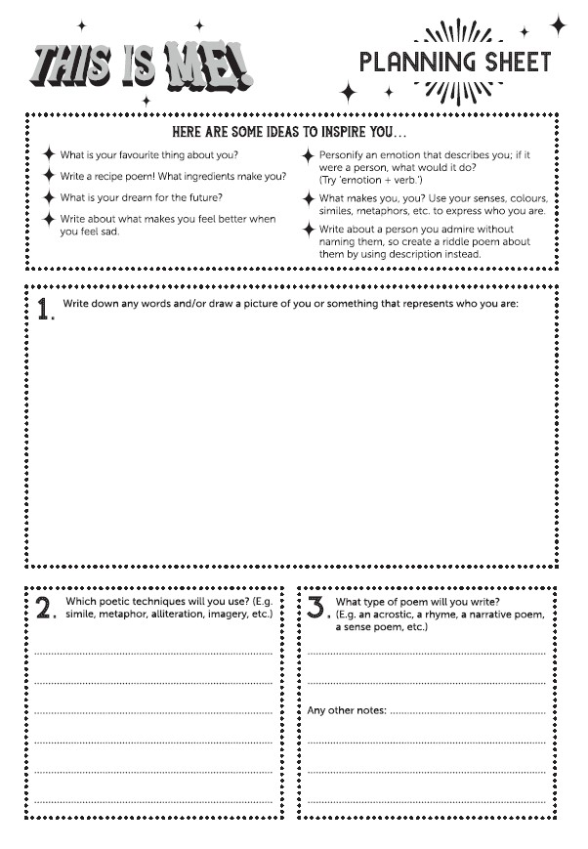
Activity Time!
Draw a picture and/or write words associated with you...
E.g.
What you love
What you dislike
How do you see yourself?
From hobbies, friends and pets to food and books, there is a lot to inspire you!
You can draw your picture in box 1 on the planning sheet or on a piece of paper/whiteboard.

Slide 8
Your picture/words are now your mind map!
Pick 5 (or more) things to create a poem with from your mind map...
For example, your drawing might show:
a football
your dog
the words, ‘sporty’, ‘brave’, ‘chatty’ and ‘love animals’.

Slide 9


Now, being inspired by Kate Wakeling’s idea, you should think about how to describe yourself as something else...
In the same way Kate describes a garden pea as:
“a frog football”
or
“an ocean-free planet”
So, rather than say “I love football”, you could say, “I am a superstar striker” or “I am a lightning bolt in football boots”.

Slide 10

Using the mind map ideas of...
a football
a dog
the words, ‘sporty’, ‘brave’, ‘chatty’ and ‘love animals’
Here is an example poem:
I am a lightning bolt in football boots,
I am a superstar striker,
I am a lover of animals, Buddy the dog is my favourite,
I am a lion, strong and brave,
I am as kind as a nurse,
My hair is a red rose,
My eyes are green marbles.
This is me.
Which poetic techniques can you spot?

Slide 11
Exploring Poetry Types – An Acrostic
This Is Me!
T iny in size
H ave many annoying habits so I am told!
I love learning and reading
S easide is my favourite place to be
I really love my family
S ometimes I make cakes with them
M e and my friends have fun playing, they are great!
E lephants are my favourite animal – I love their long trunks and flappy ears!

Slide 12
Exploring Poetry Types – A Kennings Poem
Me – A Kennings Poem
I am a…
Book reader
Wasp fleer
Tennis watcher
Summer wisher
Chocolate eater
Early riser
Bread and jam maker
Light sleeper
And finally…
A good helper!

Slide 13
Exploring Poetry Types – A Riddle Poem
My Favourite Animal
A creature of land and sea, but not the sky
It has wings but it cannot fly.
Black and white with a hint of yellow
This is a regal fellow.
Sleek and swift in the ocean
But on land has a waddling motion.
They huddle from Antarctic storms
Hold eggs on their feet to keep them warm.
What is it?
Answer: An emperor penguin.

Slide 14
Exploring Poetry Types – A Rhyme
My Dog Lady
My dog is the love of my life
She looks like a ball of fluff and gives us a lot of strife!
She sounds like a big growly bear
About her I really do care
She smells like dog biscuits and stinky breath
Sometimes she creeps up on me and scares me to death!
She is as fast as a Ferrari and as jumpy as a kangaroo
And she loves licking you
She is as loud as a jumbo jet but as small as a flower
She can pounce as high as the Eiffel Tower!
I love to take her on a walk and after we rest
She is Lady, my wonderful dog, she really is the best!

Slide 15
Exploring Poetry Types – A Rap
This Is Me
Generous, kind,
A super-fast mind
Maths is my superpower
But geography makes me cower
I jump, I sprint,
I’m a super sporty kid
A life-long football fan
I go to matches whenever I can
I’m sweet, I’m sour,
Depending on the hour
Sometimes I make a riot
Sometimes I crave the quiet
Most days are good days and then I’ll make you smile
But some days are bad days and I’m mad, but just for a while
So this is me,
Sometimes sad, mostly happy
And to bring bad moods to a super-quick end
I rely on my amazing gang of lunatic friends.

Slide 16
Exploring Poetry Types – A Recipe Poem
To create me you will need:
A book-filled bedroom
A slab of hot cheesy pizza
10lb of fun and mischief
A pinch of fun
A dash of brightness
A sprinkle of happiness
Now you need to:
Add 10lb of fun and mischief
Mix in a book-filled bedroom
Stir roughly while adding a slab of hot cheesy pizza
Next add a pinch of fun and a dash of brightness
Spread the mix neatly over a tray of baking paper
Cook until glazed and fun-filled bubbles can be seen
Sprinkle on happiness and leave to cool down.
This is me!

Slide 17
It’s time to write your
“This Is Me” poem!
Ask your teacher any questions you may have now...

Slide 18
Peer Assessment Time!
Work in pairs and read your poem to your partner.
Your partner is to provide feedback; something they like about your poem and a suggestion on how it could be improved.
Once feedback has been given and received, make any changes to your work before handing it in to your teacher.

Slide 19
It’s time to hand your work in to your teacher
Hand in your poem if you've written it out on paper or the entry form.
Email or send your work to your teacher if completed at home.
Click on 'finish' if using the Online Writing Portal.
Make sure your name and age are on your work!

Slide 20
