Slide 1
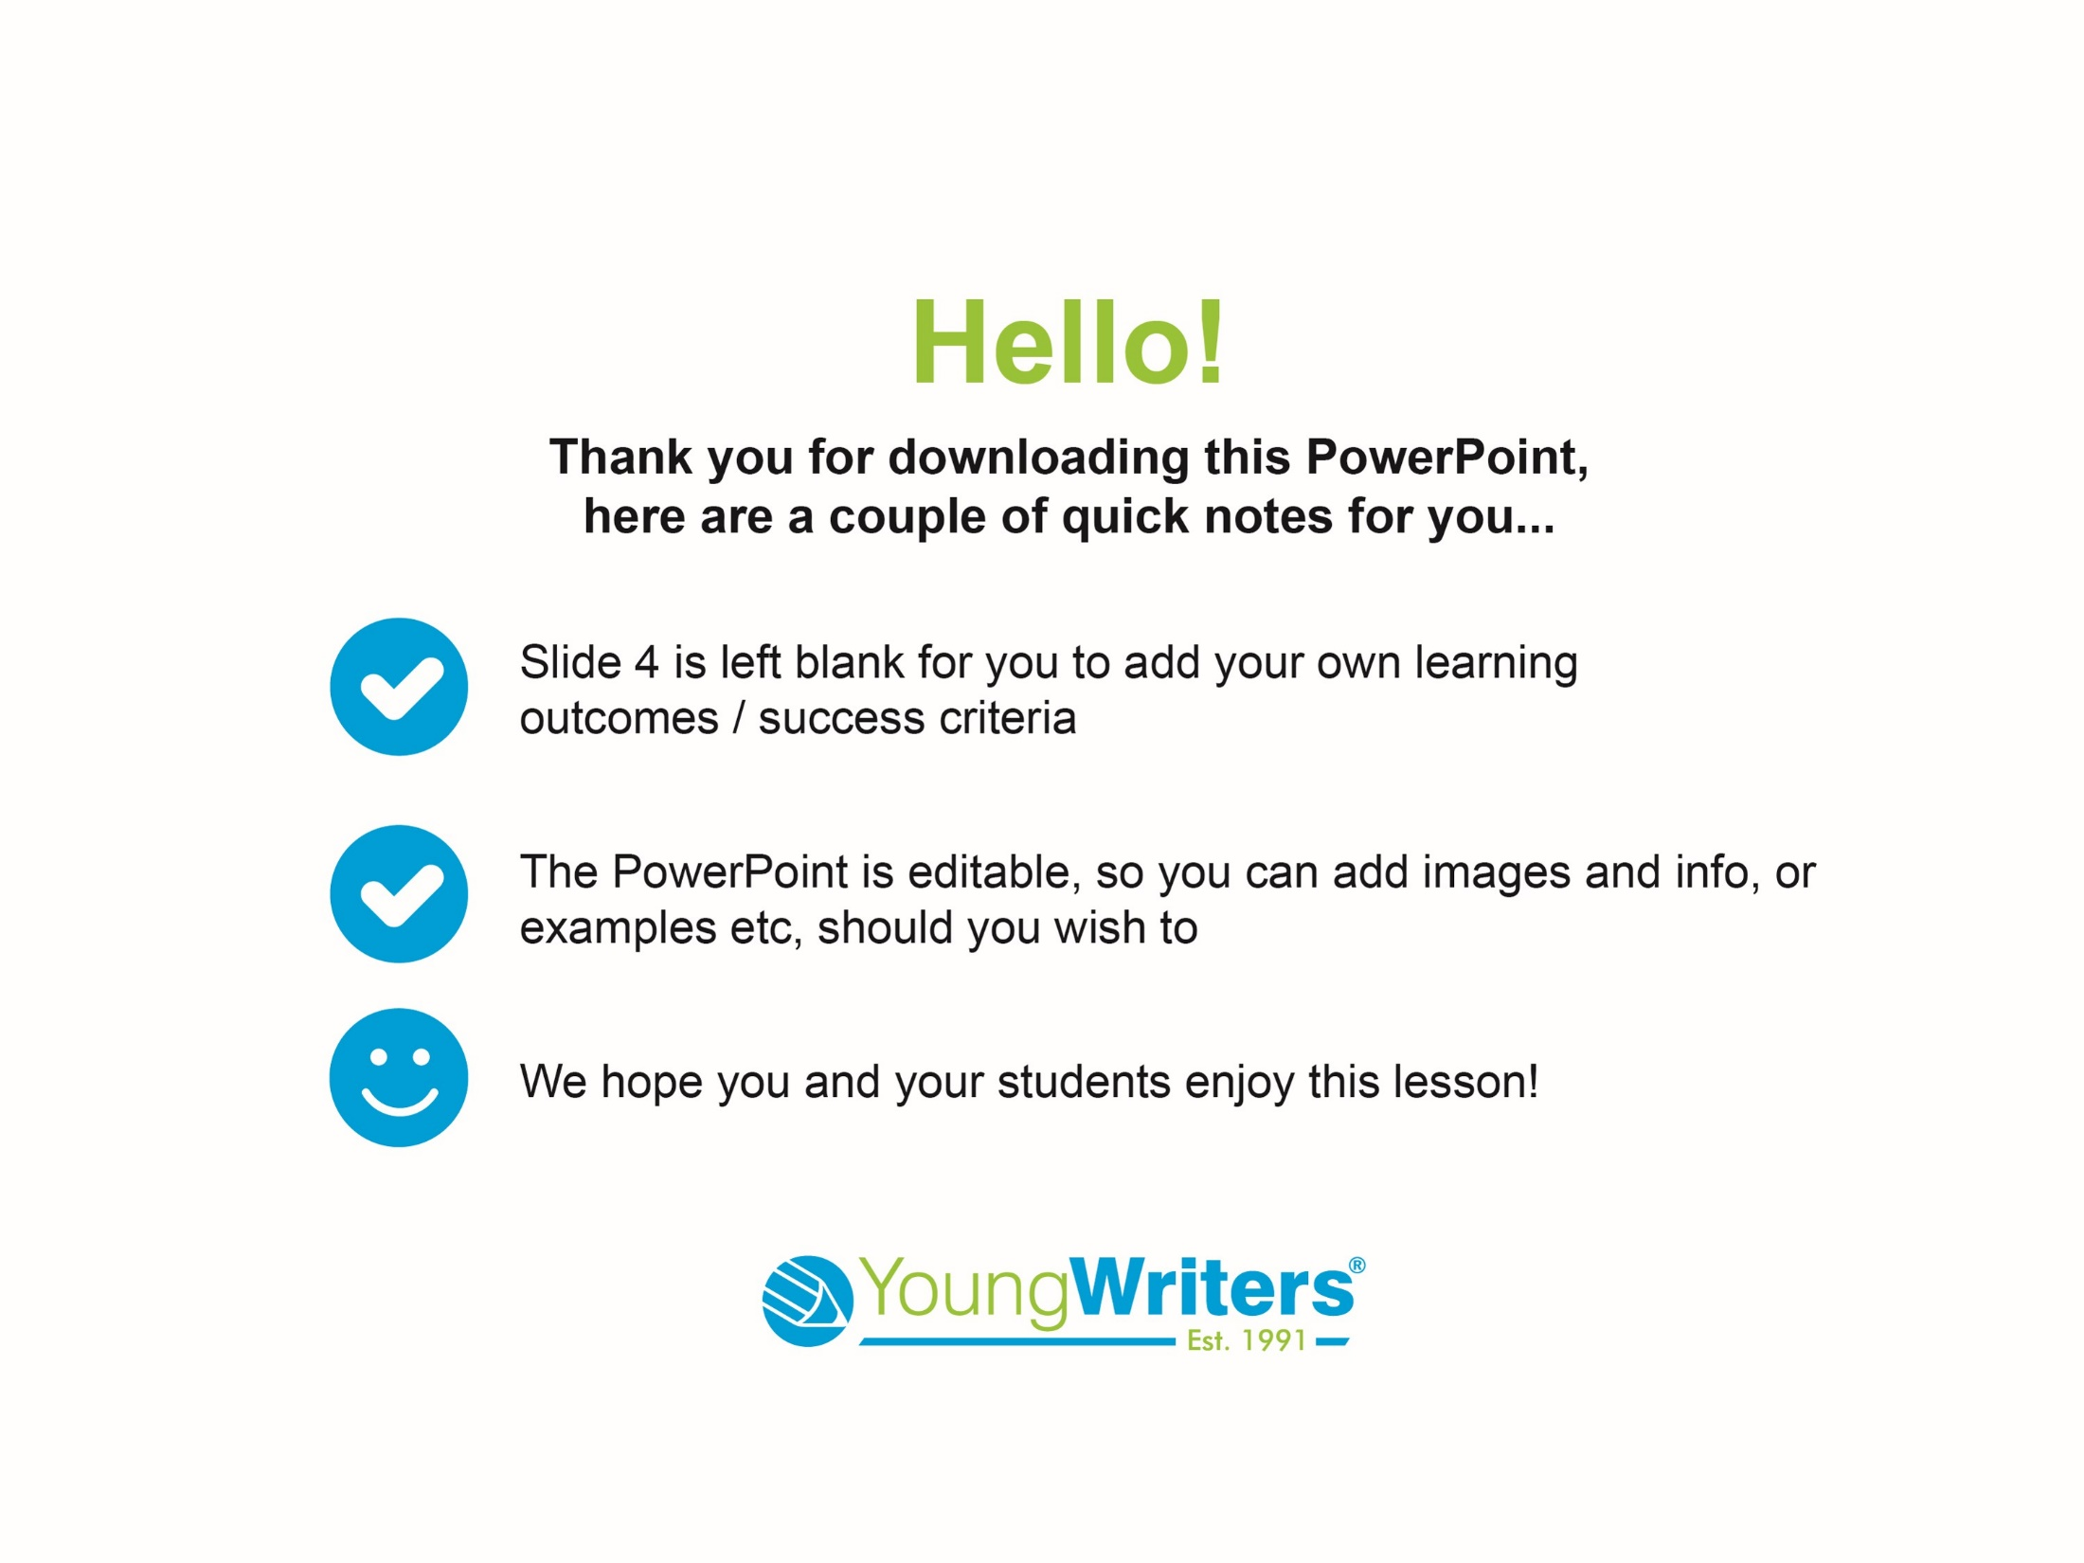

Slide 2

CREATIVE
WRITING COMPETITION
CLOSING DATE: 16th December 2022

Slide 3

Today you are going to write a mini saga
(a story told in up to 100 words) for
Young Writers’ The Big Green Writing Machine
competition.
You could be published in a book
You could win a creative writing goody bag
You could win a prize for your school

Slide 4
Success criteria for this lesson:

Slide 5
Grab a pen or open Word, etc. to
make your notes...
Let’s get started!

Slide 6
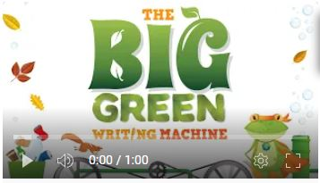
Firstly, you’re going to watch a short video that introduces you to the activity:
Notes:
https://youtu.be/oo1JM3U1UfU

Slide 7
What is a Mini Saga?
A mini saga is a story told in 100 words or fewer
It must have a beginning, middle and an end
It must be original – you can be inspired by
a story but you must make it your own

Slide 8
What is a Story?
Tell your teacher your favourite story or historical event
Your teacher will pick one
Can you tell your teacher what happens
using as few words as possible?

Slide 9
A Story’s Structure
The plot is the main events that happen in the story – you’ve just told your teacher the plot of the story you’ve been discussing
Setting – this is where the events happen, this could be in a forest, a desert, on the beach or in another country. In a mini saga, there is usually only one setting
Characters – these are the people/creatures in your story
Events – these are situations or actions that happen to
move your story along, this could be someone being
kidnapped, a strange visitor, making a new friend,
meeting a hero, etc.

Slide 10
Stories also need:
A beginning – action, dialogue or description to open your story
A middle – an event to move the story along
An ending - tie up loose ends or end on a cliffhanger
Remember, a mini saga uses up to 100 words, which means you only have one or two sentences each for the beginning, the middle and the end!

Slide 11
Identifying Key Events
Earlier in the lesson you told your teacher a story’s plot in as few words as possible
Now it’s time to see if, as a class, you can summarise the story in 100 words...
Your teacher will make notes on the board
Once you have all the key events on the board, you can then work together to write a class mini saga.
(See our tips on the next slide to help you!)

Slide 12
Tips
Be brutal – cut out any unnecessary words – do we need to know the building was high or the trees were green or that the main character likes eggs on toast for breakfast? If it’s not crucial edit it out!
Use ellipses (...) to suggest tension, excitement, mystery or danger
Abbreviate words – ‘it is’ becomes ‘it’s’ / ‘you are’ become ‘you’re’, etc.
You don’t have to get exactly 100 words, it can be fewer as long as you don’t go over!

Slide 13
Editing
Your teacher will read your class mini saga to you
Is there anything missing?
Is there anything you want to change?
Move words/lines around, add in or remove words, add in punctuation and when you are happy with it, count the words... If it’s over 100, see where you can abbreviate or edit words out.
Congratulations, you’ve written a mini saga!
Now it’s time to try writing your own...

Slide 14
The 5 Ws
It’s time to think about the 5 Ws: who, what, where, why and when – these will help you draft a rough plot of your story.
Your teacher may give you a person or time to write about,
or if not, you can use our idea generator to help you.
Who:
Who features in your story – just your main character or anyone else? Are they good or bad? Don’t add in too many characters as you only have 100 words to write your story in!
Where and When:
Where and when is the story set?

Slide 15
What:
What happens to your character?
Every story needs an event or conflict to move the plot along.
Does your character save the day, have a problem or dilemma?
Do they cause the problem or help to fix it?
What will you choose?
Why:
Why does the event or conflict happen?
Why does your character behave the way they do?
Are they in the wrong place at the wrong time?
How will you resolve the conflict / dilemma or will you
write a cliffhanger ending…?

Slide 16
Example 1
The Trapped Turtle
Choking, unable to move, a strangling collar of plastic debris wound tightly around its neck, a turtle drifted along with the current. Suddenly, a figure plunged into the sea, a dolphin at its side. It was Anti-Plastic Girl! Struggling, the turtle tried to untangle itself. Seeing its pain, Anti-Plastic Girl gently unwound its binding necklace. The turtle was free! The pair watched as the turtle swam off into the abyss. Anti-Plastic Girl's dolphin nudged her. She looked up and saw something horrific: a thick carpet of plastic covered the surface of the water. Even Anti-Plastic Girl couldn't stop this alone...
By Edith Munro (10)

Slide 17
Example 2
The Incredible Diary Of A Caterpillar-Soon-To-Be-Butterfly
Dear Diary,
I have just completed my fourteenth day in a chrysalis. I am pretty excited and pumped to become an actual butterfly! But I'm also slightly nervous. My best friend Camilla is a butterfly and she told me that her wings got all disgusting and gooey! I mean, what if that happens to me? I also heard rumours that you don't even have a proper mouth! You have to drink nectar. What even is that? I've only ever eaten leaves. And what if I don't like it? Oh, I'm really not sure I'm so excited and pumped after all!
By Delphine A (9)

Slide 18
It’s time to write your mini saga!
Remember the 3 golden rules of mini saga writing:
A mini saga must be no more than 100 words
A mini saga must have a beginning, a middle and an end
Write in your own words – every word counts, so choose carefully!
Your title isn’t part of your word count either!
Write in the 100-word grid on your worksheet.
If you have any questions, ask your teacher now...

Slide 19
Assessment Time!
Your teacher will now tell you if you are working in groups or checking your own work.
Look out for spelling mistakes, tenses changing and names spelt correctly, etc. and edit if necessary.

Slide 20
It’s time to hand your work in to your teacher!
Make sure your name and age
are on your work!
Well done for writing a mini saga for
The Big Green Writing Machine!

Slide 21

We hope you have enjoyed writing a mini saga for
A Twist in the Tale today!
CLOSING DATE:

