Slide 1
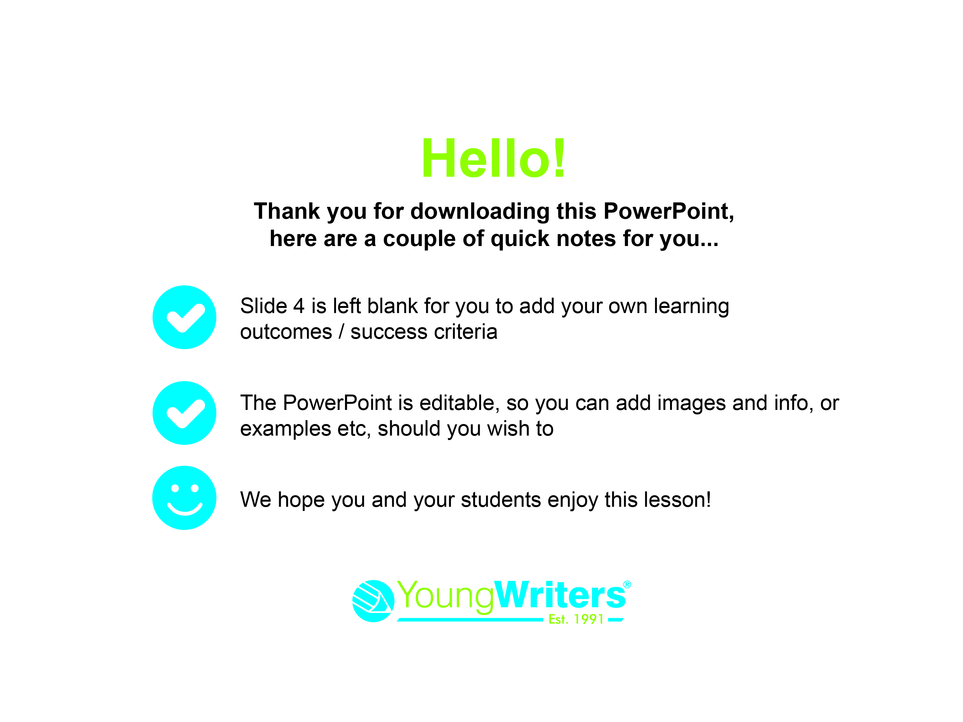
pupils enjoy this lesson!

Slide 2
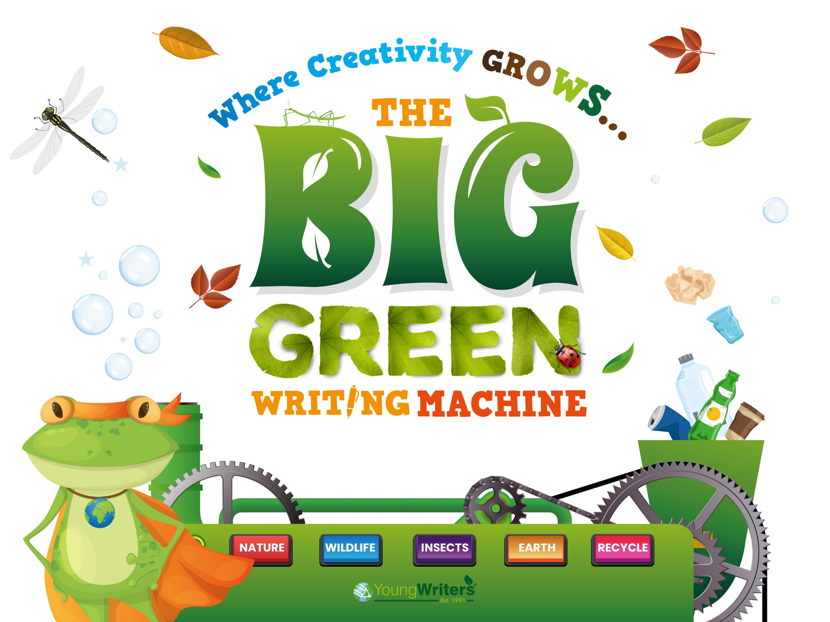

Slide 3
Today you are going to:
Learn about a selection of poetic forms and techniques
Discuss your ideas
Expand your vocabulary
Plan, draft and write a poem for ‘The Big Green Writing Machine’ competition

Slide 4
Learning outcomes & success criteria:

Slide 5
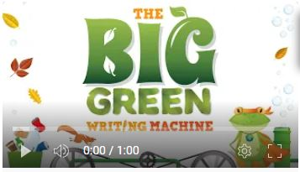
Firstly, you’re going to watch a video that introduces the activity:
Notes:
https://youtu.be/oo1JM3U1UfU

Slide 6
What is a Poem?
A poem is a piece of writing that uses imaginative words to share ideas and
emotions with the reader using techniques such as repetition, simile or
personification.
The format of a poem could be:
- Separated into verses
- One single verse
- A poetic form such as an acrostic, riddle or kennings poem
Does a poem have to rhyme? NO!
You can use rhyme if you want to, but you don’t have to!

Slide 7
What Can I Write About?
Your teacher may give you a subject and/or poetic style to write in.
If not, now is the time to think up an idea to write about, here are some suggestions to help you:
- Pick a nature or environment-themed word to write an acrostic
- Be inspired by your favourite animal, plant or green space
- Write 4 x haikus about seasons/weather
- Use ‘Our Planet’ as a title

Slide 8
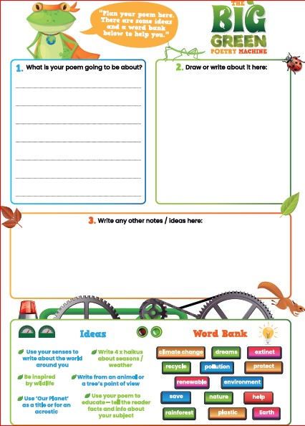
Your Planning Sheet...
- Write what your poem is going to be about in box 1
- Draw a picture of what your poem is about in box 2
- In box 3 start to note down any ideas

Slide 9
What is Personification?
Personification is a long word that simply means making an object or idea do something only a human can do!
E.g.
An ocean might say:
Plastic swims through me, making me cry
What would an animal, or a tree, say if they were talking to us?
Write down any ideas for your poem in box 3 on your
planning sheet.

Slide 10
What is a Metaphor?
It is where you describe something as something else...
- Choose a noun from one of your lines to change to a metaphor.
- Think of words that describe your noun:
E.g. If you had the word ‘river’
You might write ‘long, cool, watery, clear’
- Now think of other things that share the same description
E.g. Ribbon, ice, liquid, glass
- Use these new items to describe your noun
E.g. Ribbons of liquid glass flow through me

Slide 11
What is Alliteration?
It’s where you use the same letter or sound at the beginning of words:
E.g. Using river as our word again, if you said ‘fish swim in me’
You could use alliteration to change the line to
‘My waves are filled full of flitting fish’
What words with the same letter or sound can you think of to describe your theme? Pop your ideas in box 3 on your planning sheet.

Slide 12
What is Imagery?
Imagery is how you describe your subject so the reader can imagine what you’re doing or seeing.
- You can create imagery by using your senses – what can you (or your poem subject) see, feel, hear, smell, taste?
- Who or what is nearby?
- How does this make you (or your poem’s subject) feel?
- What descriptive words can you use?
- What poetic techniques can you include?

Slide 13
Now it’s time to write your
own, original poem…
If you have any questions, ask your teacher now!

Slide 14
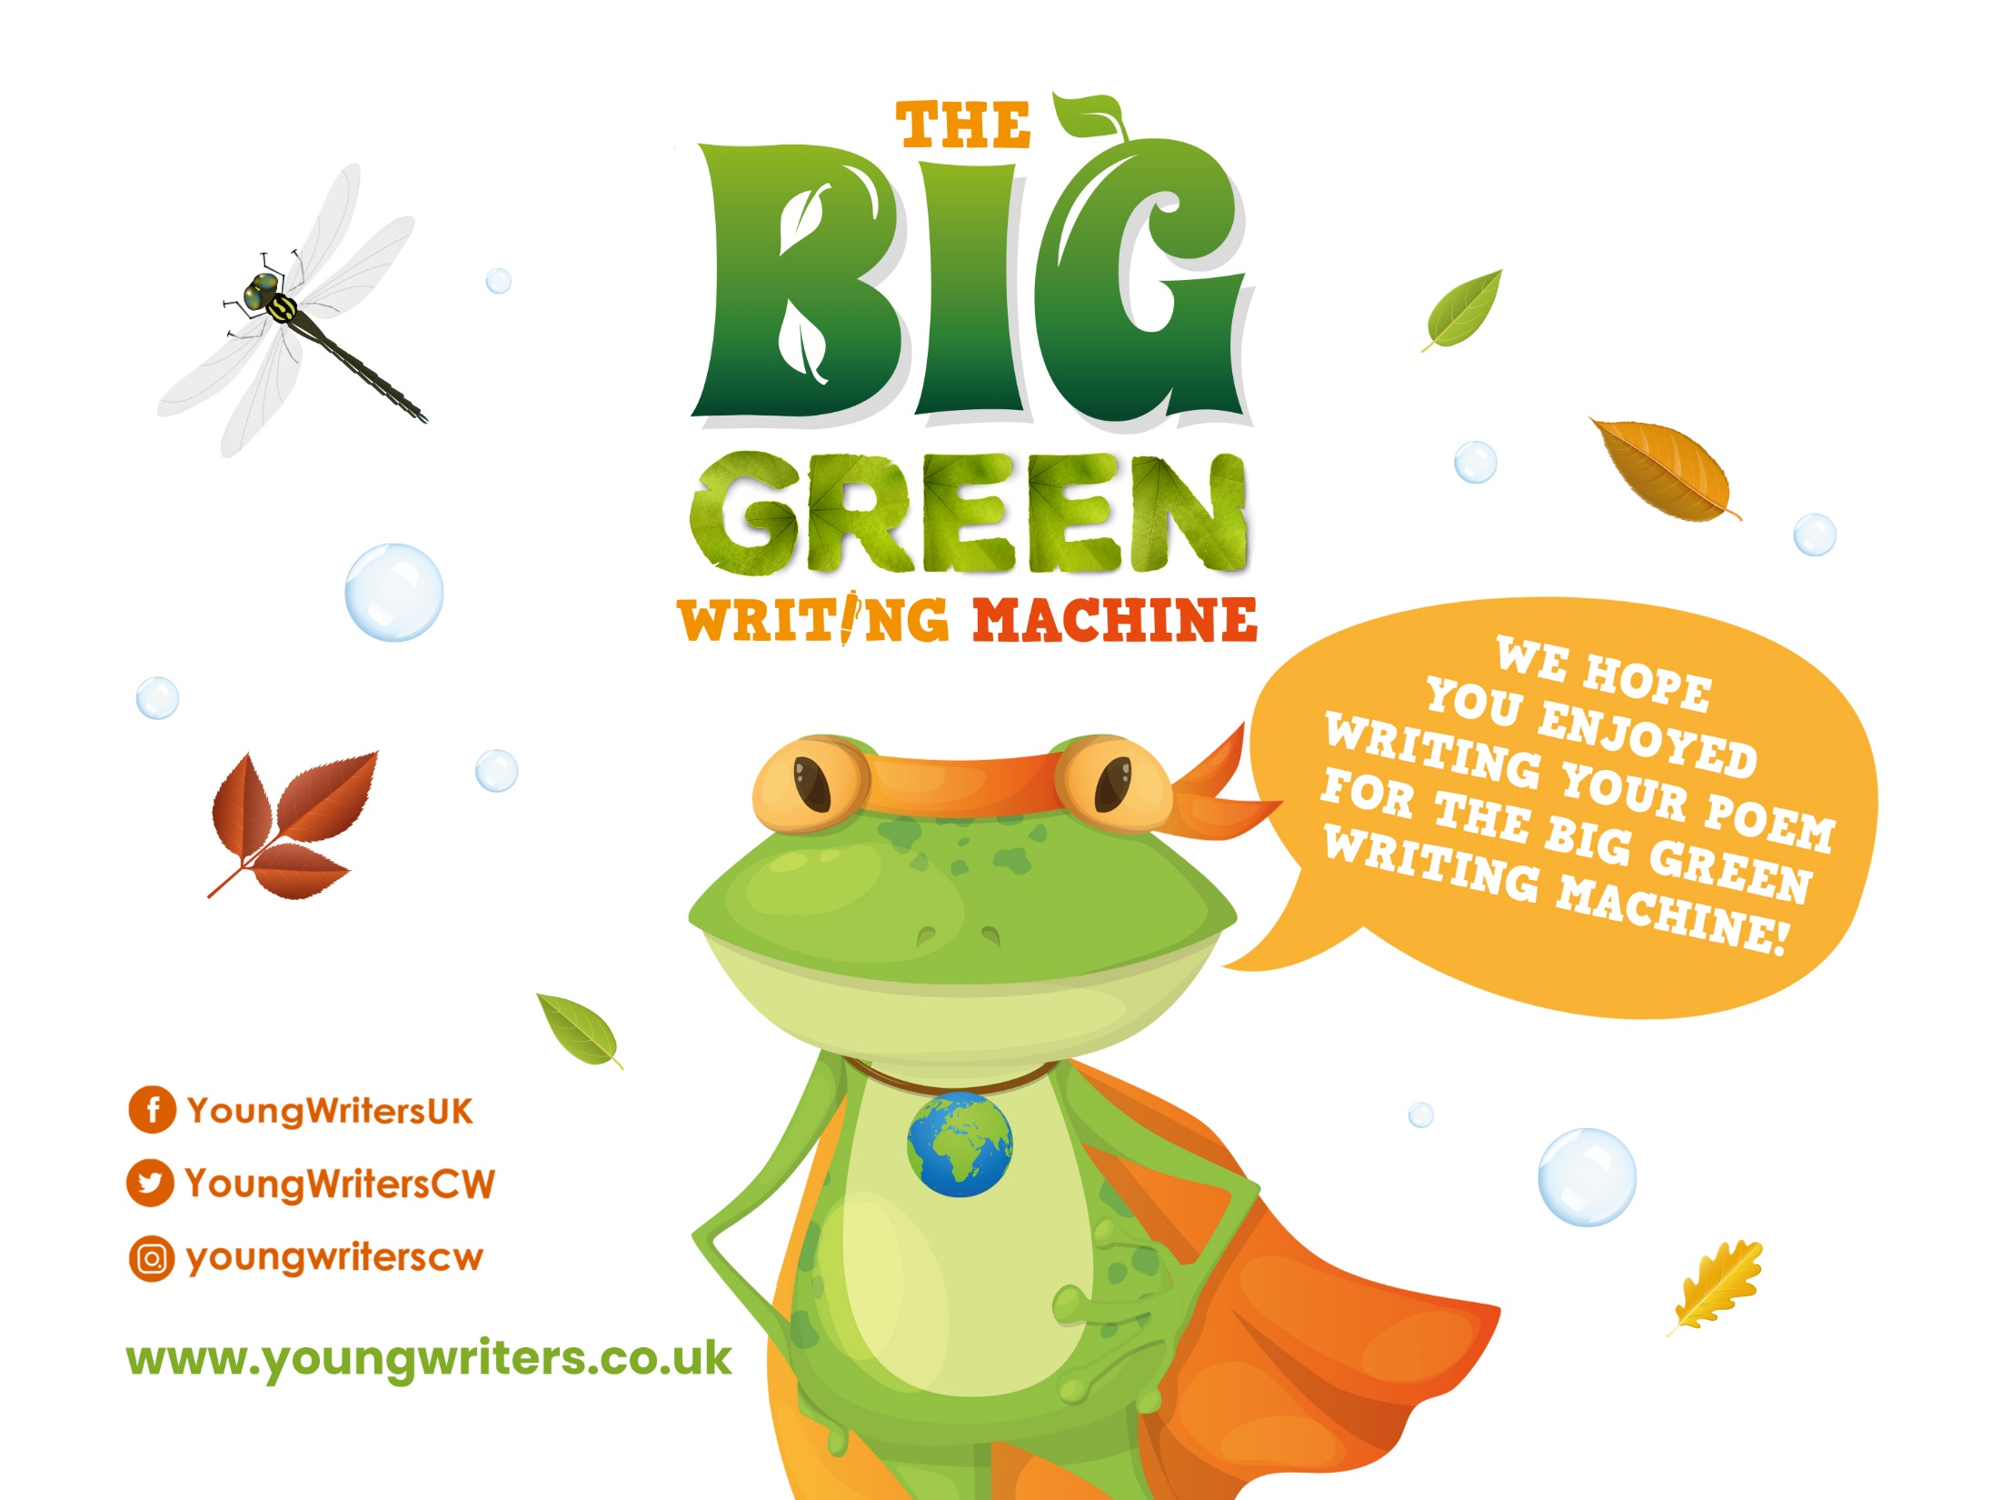
Peer Assessment Time!
Work with a partner
Read your poem to them
Your partner is to provide feedback; something they liked about the poem and a suggestion on how to improve
You then listen to your partner’s poem and provide them with feedback
Make any changes to your work before handing it in to your teacher

