Slide 1
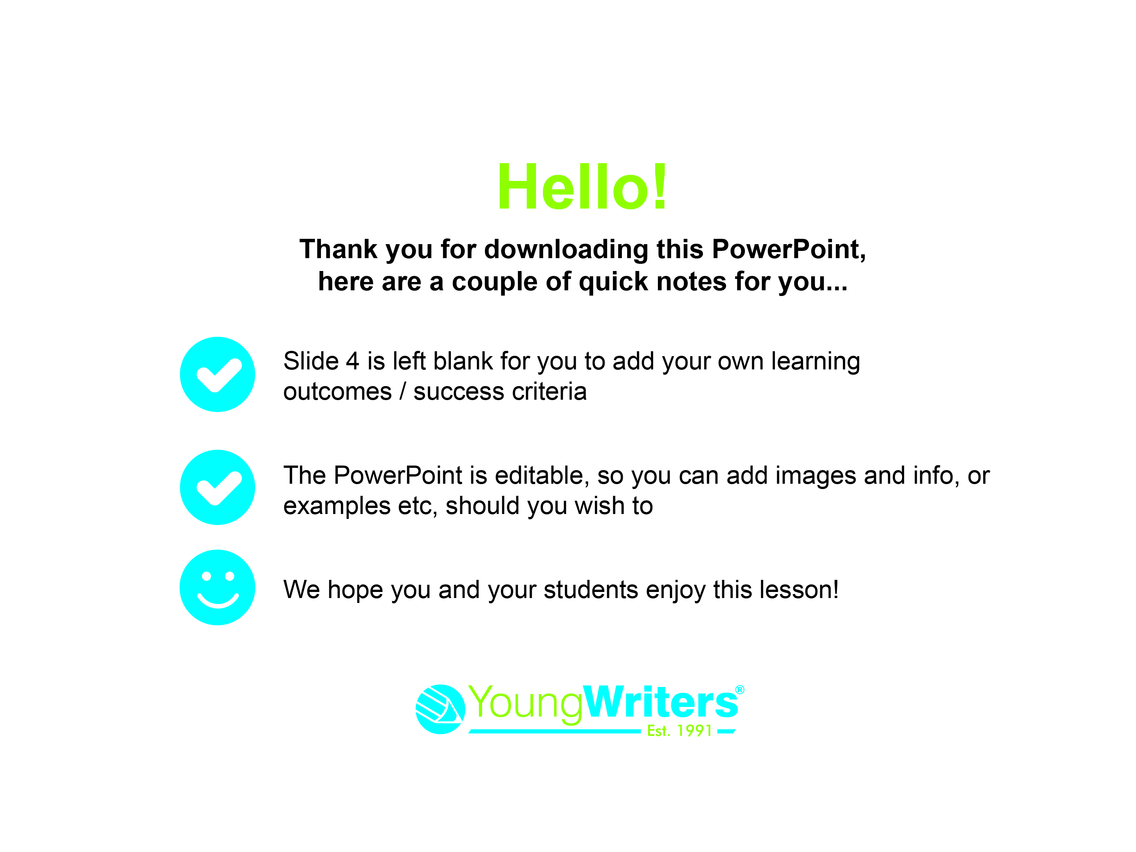

Slide 2


Slide 3

Today you are going to
write an acrostic poem for the Little Dreamers
competition!
Get your pencil or whiteboard to make notes.
Let’s get started!

Slide 4
Learning Outcomes and Success Criteria for today’s lesson:

Slide 5
What is an acrostic poem?

Slide 6
An acrostic is a poem where the first letter of each line spells out a word down the page. Like this:
Shooting stars
Planets everywhere
Aliens live here
Colourful sky
Earth

Slide 7
Let’s write an acrostic poem as a class.
We will use the word dream

Slide 8
D
R
E
A
M
Can you think of any words or sentences that start with these letters to describe a dream?

Slide 9
D
R
E
A
M

Slide 10
Here’s our acrostic:
Dream when I sleep
Really fun
Every night
Amazing adventure
Magical

Slide 11
Now it’s time to write your own
acrostic poem

Slide 12
Step 1.
Look at these poem ideas:
I dream about…
When I grow up I want to be a…
I dream of playing with…
I dream of going to…
My superpower is…
I am scared of…

Slide 13
Tick one of the ideas on your planning sheet to use.
Write a word to finish the sentence.
This will be your acrostic word!

Slide 14

We have chosen:
I dream about…
Dragons
………………………………………………………………….

Slide 15
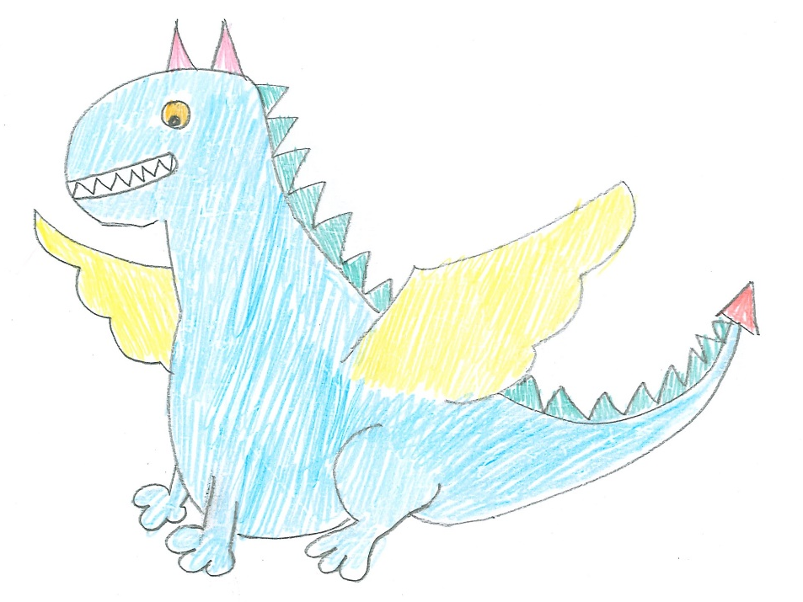
Step 2.
Draw a picture of what your poem is about.

Slide 16
Step 3.
Write down words or phrases that describe your acrostic word.
Green spikes
Orange eyes
Scary
Breathes fire
Big wings
Loud roar

Slide 17
Step 4.
Write your acrostic word down the side of your page.
D
R
A
G
O
N
S

Slide 18
Step 5.
See if any of your describing words start with the same letters that are in your acrostic word.
You can use these to start building your poem.
You might need to add words or turn them into sentences to make them fit.

Slide 19
Loud
roar
Dragons
Roar loudly
Always fly
Green spikes
Orange eyes
Noses that breathe fire
Scary and fierce
Green
spikes
Breathes
fire
If you have any gaps, think of another line or word to add in.

Slide 20
Well done!
You’ve written a Little Dreamers
acrostic poem!

Slide 21
Can you make it even better?
Can you add more describing words to your poem?
Read your poem to a friend and ask them if they like it.

Slide 22
It’s time to hand your work in to your teacher!
Make sure your name is on your poem

Slide 23


