Slide 1
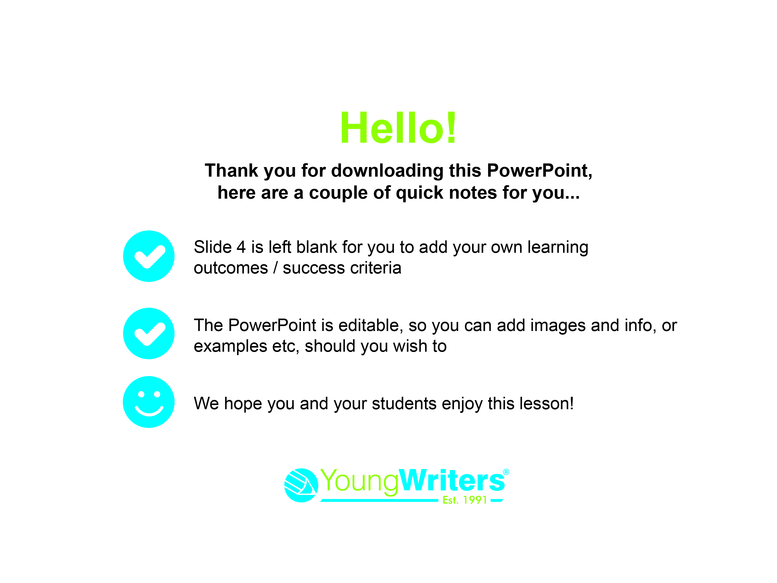

Slide 2


Slide 3

Today you are going to write a short story for Young Writers' The Glitch competition.
You could be published in a book
You could win a trophy and £50
You could win a prize for your school

Slide 4
Success criteria for this lesson:

Slide 5

First watch this short video which introduces The Glitch
https://youtu.be/9O8hS8si_dA

Slide 6
Speculative Fiction
Does anyone know what 'speculative fiction' means?

Slide 7
Speculative - Adjective: based on a guess and not information
Speculative fiction is a story that takes place in our world, but with an added magical, supernatural, futuristic or other twist that creates a ‘what-if’ scenario.

Slide 8
Here are some examples of books that can be classed as speculative fiction.
Discuss what you think the 'what if' scenarios are for each one.
Twilight
Lord of the Flies
Percy Jackson series
They Both Die at the End
Harry Potter series
Peter Pan
The Hunger Games
Jurassic Park
(Don't worry if you're not familiar with some of them, do the ones you can or guess! Your teacher may give you different examples.)

Slide 9
Here are the answers we came up with:
Twilight – what if vampires were real and a high school girl fell in love with one?
Lord of the Flies – what if a group of boys had to fend for themselves on an island?
Percy Jackson series – what if you discover you are half Greek god?
They Both Die at the End – what if you knew you were going to die today?
Harry Potter series – what if a boy discovers he's a famous wizard?
Peter Pan – what if there was a magical land where children don’t grow up?
The Hunger Games – what if children were sent to fight to the death for the entertainment of the elite?
Jurassic Park – what if dinosaurs were brought back to life?

Slide 10
Elements of Speculative Fiction
Now you have some examples of speculative fiction novels, think about what they have in common.
What elements are present in speculative fiction?
You could think about themes, settings, characters or plot points.

Slide 11
Here's our list. Did you get any of these? Are there any that you thought of that we missed?
Magic
Alternate realities or parallel universes
Future or advanced technology
Supernatural phenomena
Alien life
Reimagining historical events
Good vs evil
Future of humanity
Superpowers
Ordinary people in extraordinary circumstances

Slide 12
Writing a Mini Saga
You'll be writing your speculative fiction in the form of a mini saga.
A mini saga is a story told in 100 words. There are three golden rules you need to stick to:
Be original! You can be inspired by other stories, but the plot must be entirely your own.
Keep to the 100-word limit – every word counts!
Remember that mini sagas still need to have a beginning, a middle and an end.

Slide 13
Exploring Plot Ideas
There are 8 postcards around your classroom.
Each one has a story starter – a short sentence that you can use to start or inspire your story.
When your teacher tells you to, get up and look around for the postcards. Read them all carefully and consider each one before moving to the next.

Slide 14
Which story starter sparks an idea for a story in your mind?
Choose your favourite and mark which one you have chosen on your planning sheet.
Take a moment to re-read it and think about the character and setting it suggests to you.

Slide 15
Planning Your Mini Saga
Complete the rest of your planning sheet.
Remember you will only have 100 words to tell your story, so make sure you don't add in too many characters or plot points.
What are the consequences of the glitch in your story? Does it get fixed, or does your character have to adapt to the new reality?

Slide 16
It’s nearly time to get writing, but before you start, here are some tips for writing a whole story in just 100 words:
Contract words e.g. it is becomes it’s
Start as close to the end of the story as possible – dive right into the action!
Cut out unnecessary words e.g. And then when I arrived I… becomes Arriving, I...
Are there any actions or images that can be expressed in fewer words? E.g. I ran fast becomes I sprinted

Slide 17
Get Writing!
Here’s a reminder of the three golden rules of mini saga writing:
  1. Be original! You can be inspired by other stories, but the plot must be entirely your own!
  2. Keep to the 100-word limit – every word counts!
  3. Remember that mini sagas still need to have a beginning, a middle and an end.
  Write out your story in rough first, so you can see where you need to make cuts or change parts.

Slide 18
It's Peer Assessment Time
Share your work with a partner.
They will let you know what they liked about your mini saga, and give you a suggestion on how it could be improved, or if you need help cutting it down to 100 words, and spotting any mistakes.
Then you do the same for them.

Slide 19
Submit Your Work
Make sure your name is on your work.
  Hand in your form if you’ve written
  it on paper
  Email or upload to your teacher if you've typed it
  Submit your work if using the Online
  Writing Portal

Slide 20
